Slide 1

Whole genome sequencing as a diagnostic tool for Lynch syndrome
InSiGHT 2017, Florence, Italy
Bernard Pope
Lead Bioinformatician (Cancer Genomics, Clinical Genomics)
Melbourne Bioinformatics
The University of Melbourne, Australia
bjpope@unimelb.edu.au

Slide 2
MMR deficient CRC
Colon Cancer Family Registry
Notes:
About a quarter of patients with mismatch repair deficient tumours under 50 years of age have no known cause. In patients 50 and over this is 15%.

Slide 3
Aim
Investigate whole genome sequencing (WGS) for identifying novel germline causes of tumour MMR-deficiency.
Causes considered:
Single nucleotide variants (SNVs)
Short insertions and deletions (INDELS)
Structural variants (SVs)

Slide 4
Methods
WGS for 16 suspected Lynch syndrome patients and 2 positive controls.
Group included 2 relative pairs.
Selection criteria:
MMR deficient tumour (MMR IHC and MSI-H)
Family history of CRC and/or young age at diagnosis.
Negative for MLH1 promoter methylation.
No identified MMR gene germline mutation.
No double somatic mutation in tumour.
Positive controls:
MSH2 deletion exon 6 identified by MLPA
Intronic splice site MSH2 mutation (Clendenning et al, 2011).
Notes:
Patients were selected for a phenotype suggestive of Lynch syndrome.

Slide 5
Methods
SNVs and INDELs were called using the GATK Best Practices Pipeline.
SVs were called by DELLY, LUMPY, Socrates, and GRIDSS.
Variants filtered to those intersecting 4 tiers of genes:
MMR genes (MLH1, MSH2, MSH6, PMS2, EPCAM).
MMR-related genes from literature (MUTYH, POLE, POLD1, MSH3, MLH3, EXO1).
DNA repair genes from literature.
Genes with any rare loss of function variant identified.

Slide 6
SNVs and INDELs summary
SNVs and INDELs called
across 18 whole genomes
12.7 million total
1094 LOF variants,
0 found in tiers 1-3 genes
81.4% intronic,
control splice site variant detected but not predicted pathogenic
9631 filtered to tiers 1-3 genes
88 filtered to coding regions of tiers 1-3 genes

Slide 7
SVs summary
All 4 tools called:
9.5 Mb inversion affecting exons 1-7 of MSH2 in mother-daughter pair (validated).
1927 base deletion of exon 6 in woman with endometrial cancer (positive control).
2 other variants which may be artefacts.
SVs intersecting tier 1-3 genes, called by at most N tools
Notes:
SV tools have a relatively high false positive rate

Slide 8
Highlighted germline variants
ID | Age | Cancer | MMR IHC | MSI | Gene | Fam History | Tier | Germline Variant | CADD | REVEL | ExAC
9 | 47 | CRC | MSH2/MSH6 loss | MSI-H | MSH2 | CRC FDR | 2 | POLE p.Arg680Cys | 34 | 0.638 | 8.7E-6
11 | 40 | CRC breast | MSH2/MSH6 loss (CRC) | NT | MSH2 | CRC FDR | 1 | MSH2 inversion ex1-7
12 | 35 | CRC | MSH2/MSH6 loss | MSI-H | MSH2 | CRC FDR | 1 | MSH2 inversion ex1-7
relatives
9.5 Mb MSH2 inversion reported in: Wagner et al, Genes Chromosomes Cancer (2002).
See also Rhees et al, Fam Cancer (2014), and Mork et al, Fam Cancer (2017).
Notes:
The POLE variant was the most predicted damaging from all the identified missense variants.

Slide 9
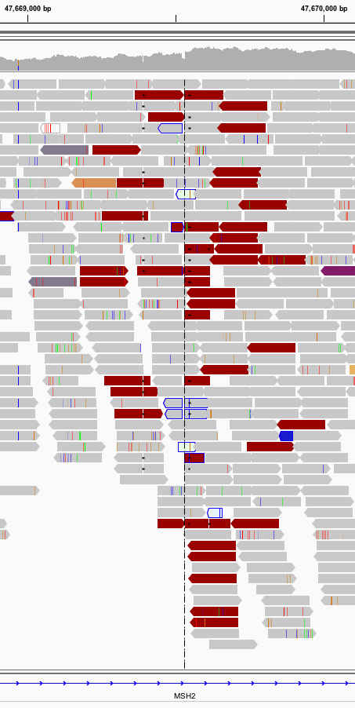
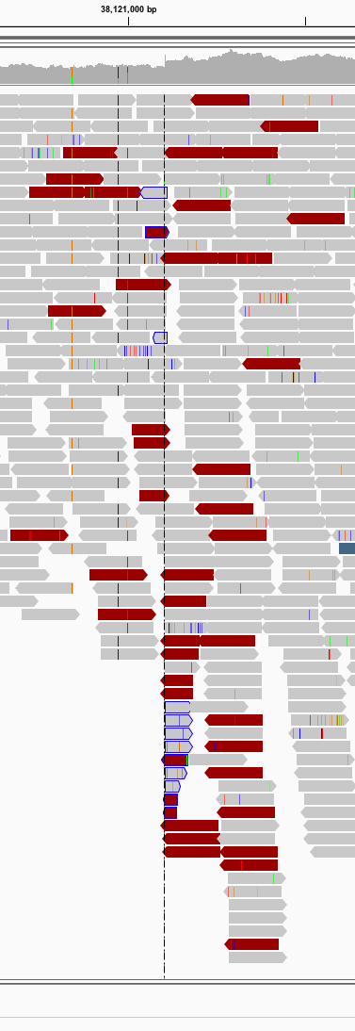
9.5 Mb inversion exons 1-7 of MSH2
MSH2
Notes:
Signature pattern of discordant read pairs at each breakpoint

Slide 10
9.5 Mb inversion exons 1-7 of MSH2
Notes:
In the family we identified an additional 6 carriers, 2 of which had early onset cancers, and one with polyps.

Slide 11
POLE p.Arg680Cys
Hypothesis: germline POLE mutations can result in two somatic mutations in one of the DNA MMR genes causing loss of protein expression (Elsayed et al, Eur J Hum Genet, 2015).

Slide 12
POLE p.Arg680Cys
Notes:
In this family we identified an additional an additional 4 carriers, one with CRC and one with polyps.

Slide 13
Conclusions
WGS can identify novel germline causes of tumour MMR-deficiency.
As cost continues to fall, may replace existing biochemical diagnostic assays.
Can detect complex structural variants
Use of multiple tools and concordance reduces false positive rate.
Can detect likely pathogenic mutations outside the current gene screening paradigm.
Variant interpretation in non-coding regions and novel genes remains challenging.
Notes:
MLPA = Multiplex Ligation-dependent Probe Amplification

Slide 14
Acknowledgements
Colorectal Oncology Group, UoM
Dr Dan Buchanan
Dr Mark Clendenning
Assoc. Prof. Christophe Rosty
Dr Harindra Jayasekara
Neil O’Callaghan
Susan Preston
Marie Lorans
Melbourne Bioinformatics
Dr Khalid Mahmood
Assoc. Prof. Daniel Park
Dr Michael Kuiper
Genetic Epidemiology Laboratory, UoM
Prof. Melissa Southey
Dr Eric Joo
Dr Ming Wong
Royal Melbourne Hospital
Prof. Ingrid Winship
Prof. Finlay Macrae
Centre for Epidemiology & Biostatistics, UoM
Prof. Mark Jenkins
Prof. John Hopper
Dr Aung Ko Win
Cancer Council Victoria (MCCS)
Prof. Graham Giles
Assoc. Prof Roger Milne
Prof. Dallas English
Molecular Epidemiology Laboratory, QIMR
Assoc. Prof. Amanda Spurdle
Rhiannon Walters
Australasian Colorectal Cancer Family Registry (ACCFR)
Australian National Endometrial Cancer Study (ANECS)
Lynch Syndrome Australia (www.lynchsyndrome.org.au)
National Health and Medical Research Council, Australia (NHMRC), APP1125269.

